Slide 1
Vehicle Insurance Claim Fraud Detection Presented by Ben George – K00278093 Della Davis Cheruvathoor- K00278225 Jismin Kalarickal Antony - K00278293

Slide 2
Problem Identification
Vehicle insurance fraud is the conspiracy to make false or exaggerated claims for property damage or personal injuries as a result of an accident. The project's goal is to forecast potential future claim fraudulent or not based on existing data.
The likelihood of fraud is predicted by comparing various parameters such as base policy, policy type, vehicle category, and fault.
We provide various machine learning models through Data Robot to regulate better decision making in financial operations such as insurance claim acceptance.
We considered the features or parameters and their influence on fault prediction by correlation. On the basis of which different models are deployed to compare the accuracy of claim acceptance and rejection.
.

Slide 3
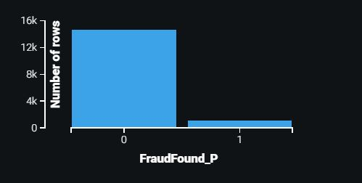
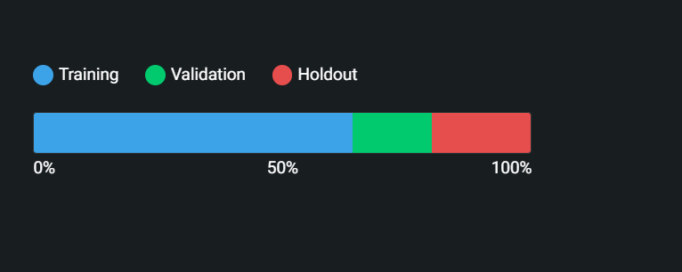
Dataset & Summary statistics
Vehicle insurance claim fraud detection dataset from Kaggle contains information's such as attribute, model, accident details, and so on, as well as policy information such as policy type, tenure. It has 33 variables, 25 of which are categorical and 8 of which are numerical.
The dataset is divided into 33 attributes spread across 15,421 rows.
Target Variable: Fraud found (Binary value indicating fraudulent claim or not)
The following are the key factors that influence prediction:
Base policy
Policy Type
Fault
Vehicle category

Slide 4
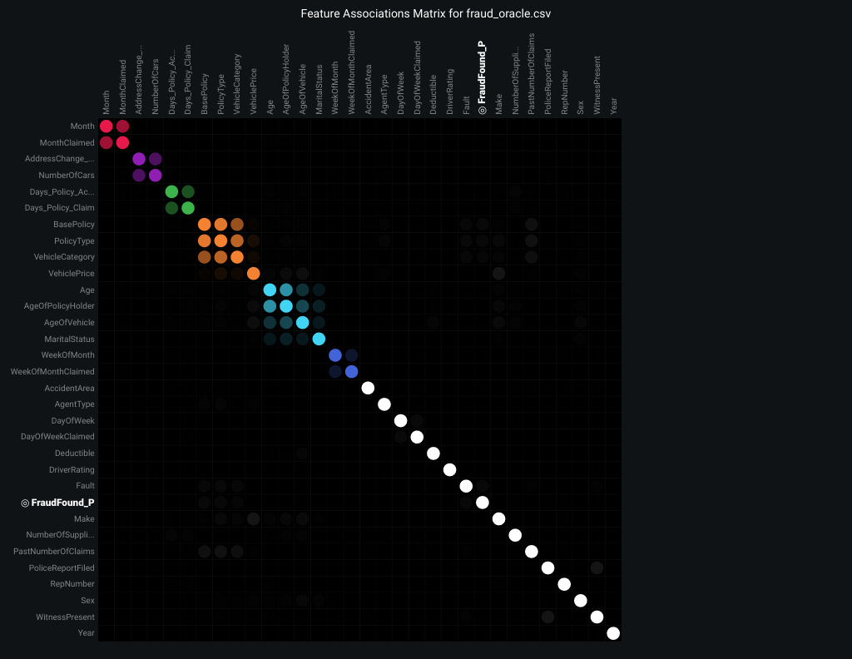
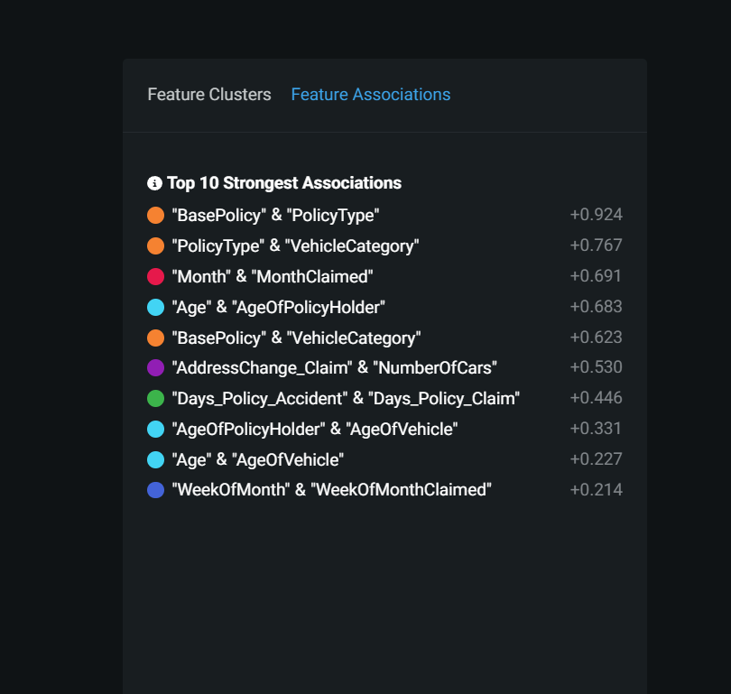
Feature Association

Slide 5
EXPLORATORY DATA ANALYSIS
1

Slide 6
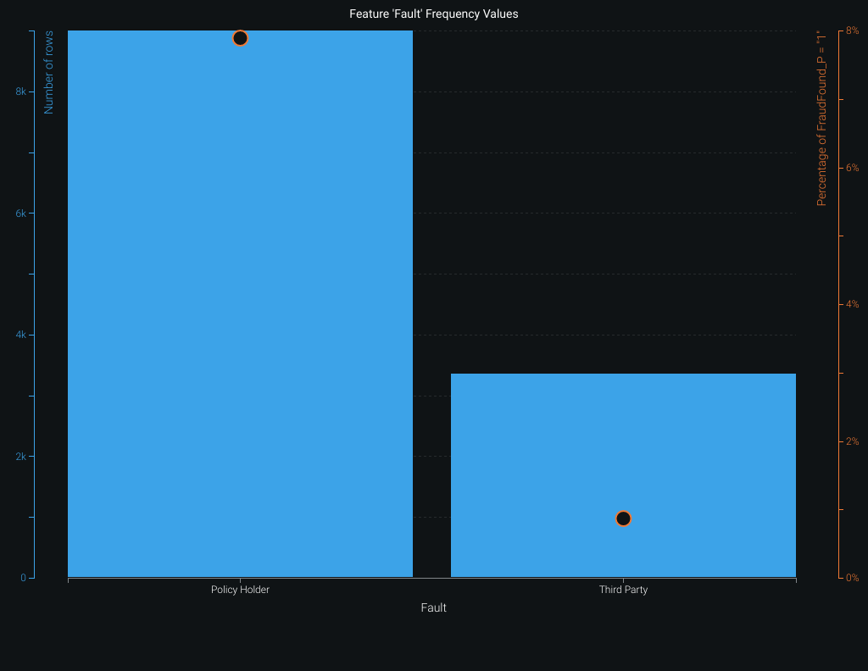
Fault VS Fraud Found

Slide 7
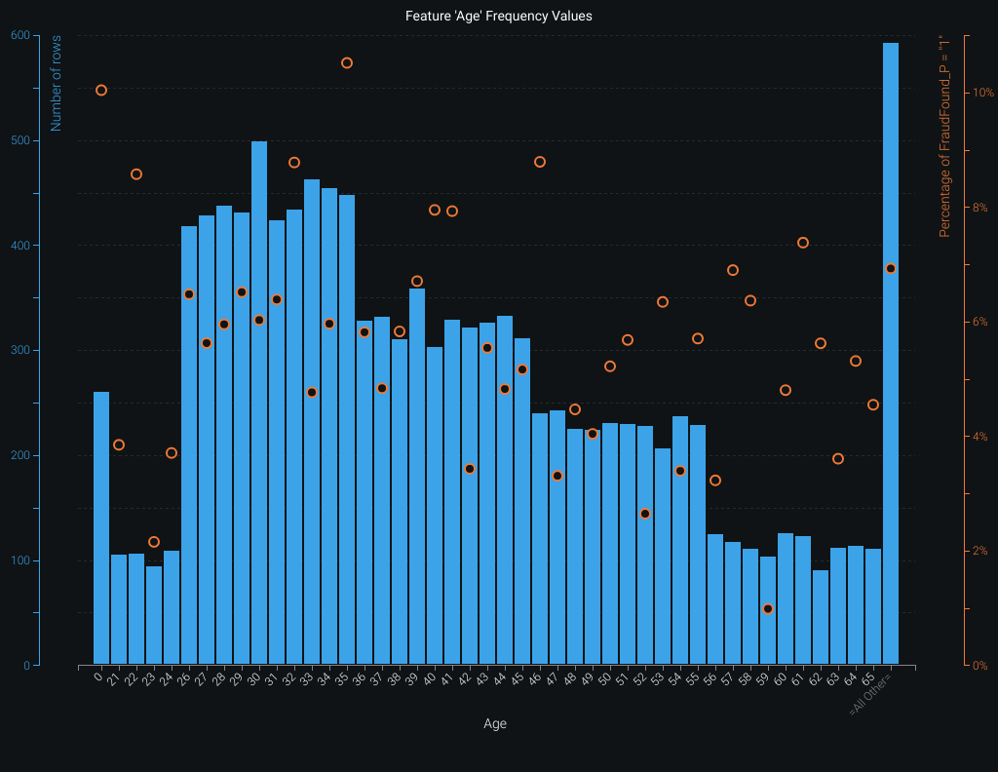
Age VS Fraud Found

Slide 8
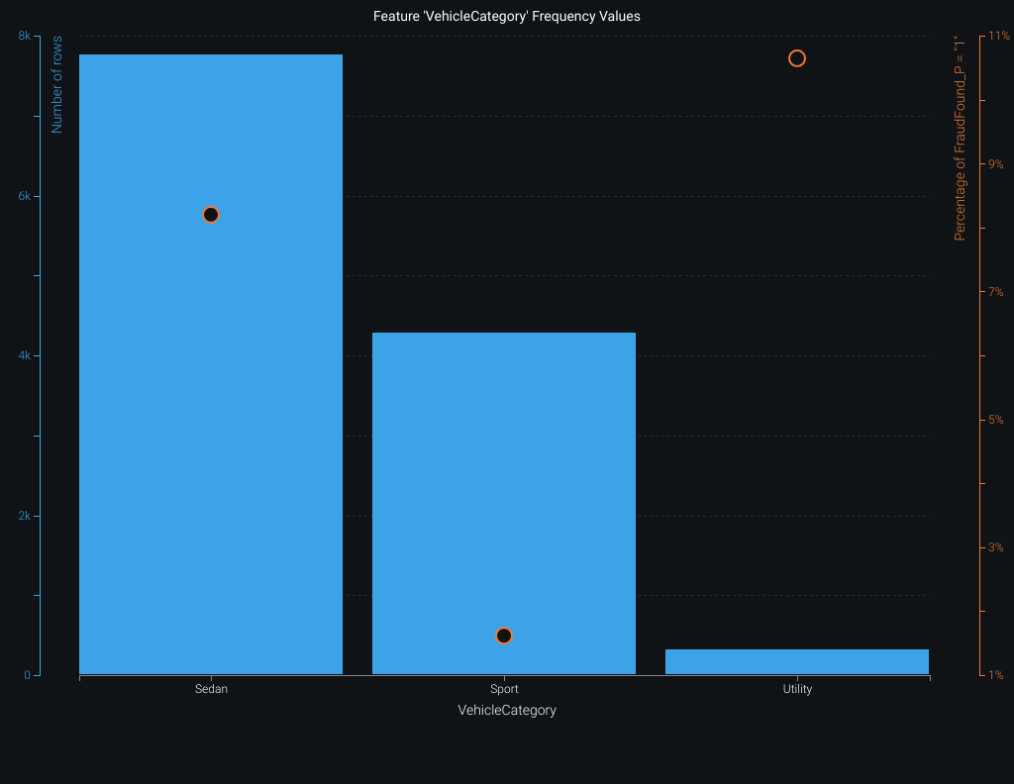
Vehicle Category VS Fraud Found

Slide 9
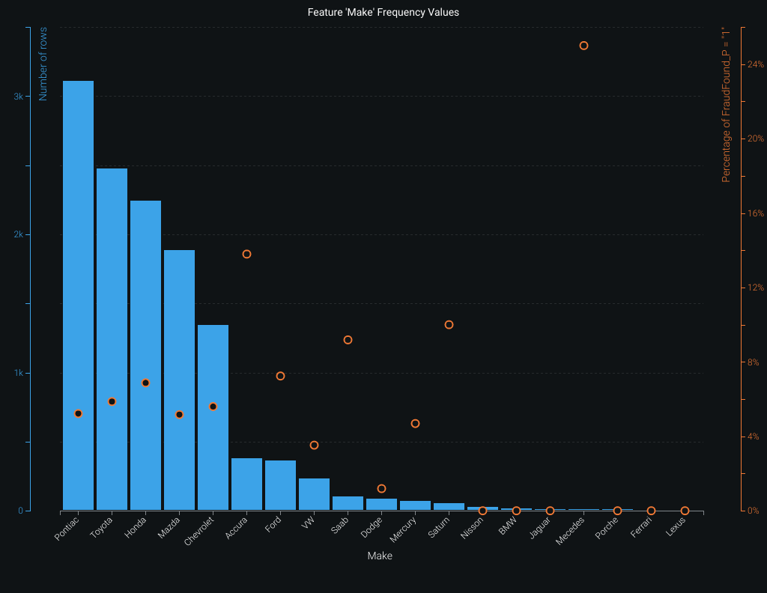
Vehicle Make VS Fraud Found

Slide 10
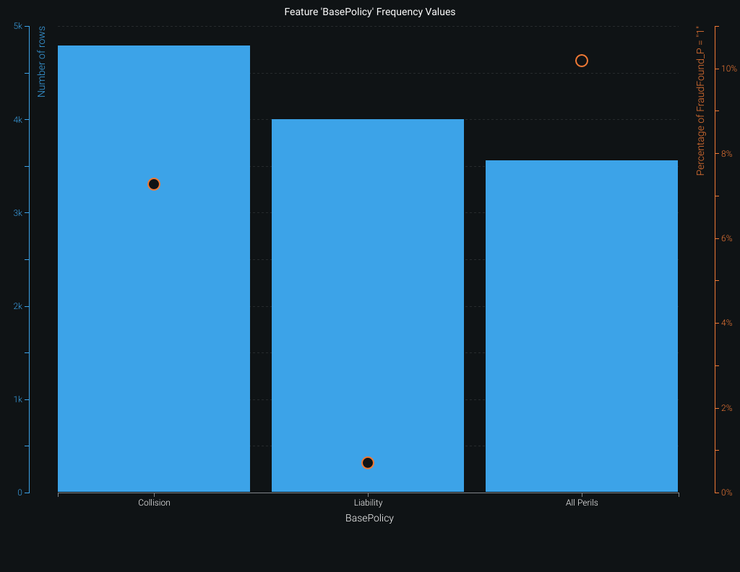
Base Policy VS Fraud Found

Slide 11
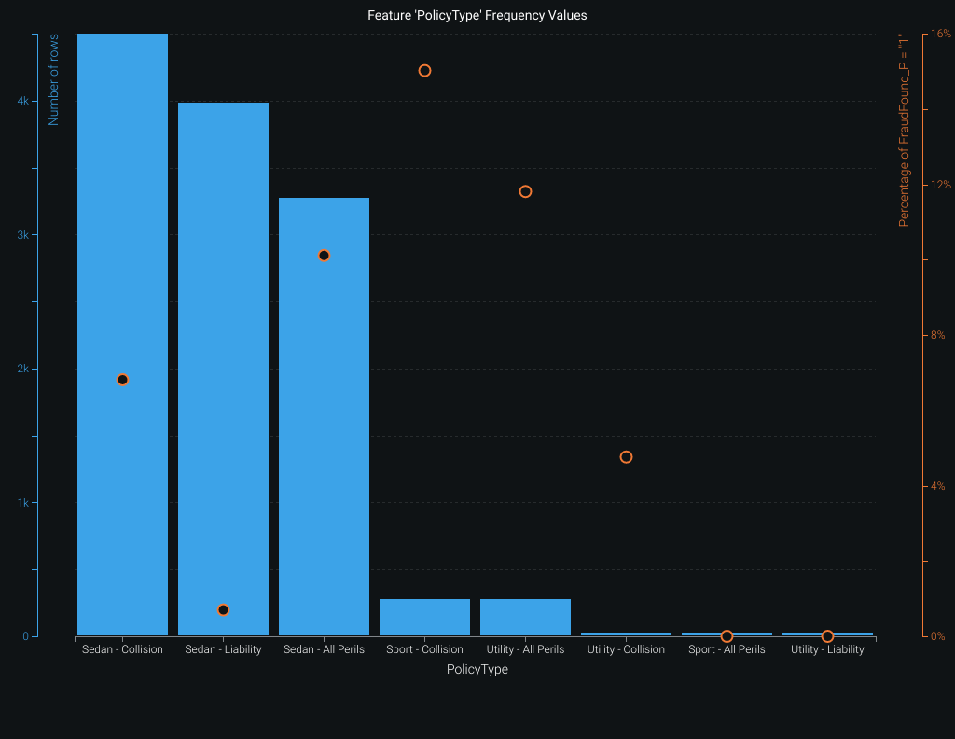
Policy type VS Fraud Found

Slide 12
DATA MODELLING

Slide 13
RECOMMENDED MODELS
Data Robot generated 9 models by default for the vehicle insurance claim Fraud detection dataset we provided.
The "Log Loss" value will be used to compare models.
Lower the “Log Loss” more accurate the model.
The following high-performing classification models were generated:
eXtreme Gradient Boosted Trees Classifier with Early Stopping
Generalized Additive2 Model
Light Gradient Boosted Trees Classifier with Early Stopping

Slide 14
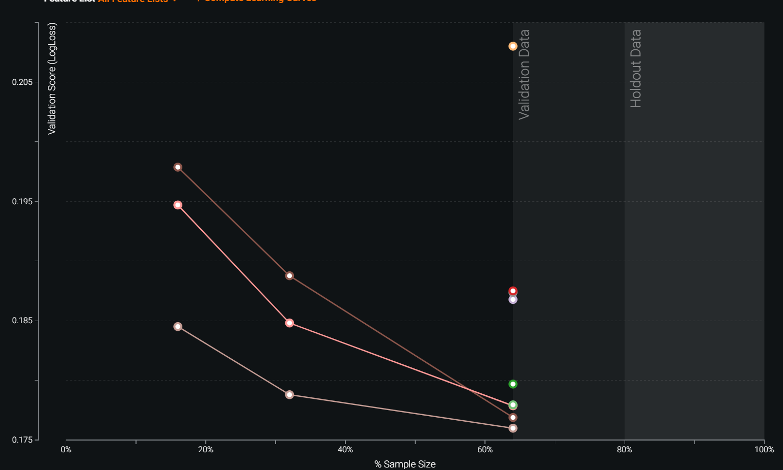
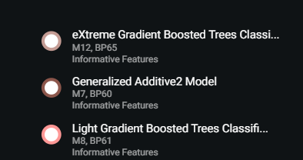
Model Identification by learning curve

Slide 15
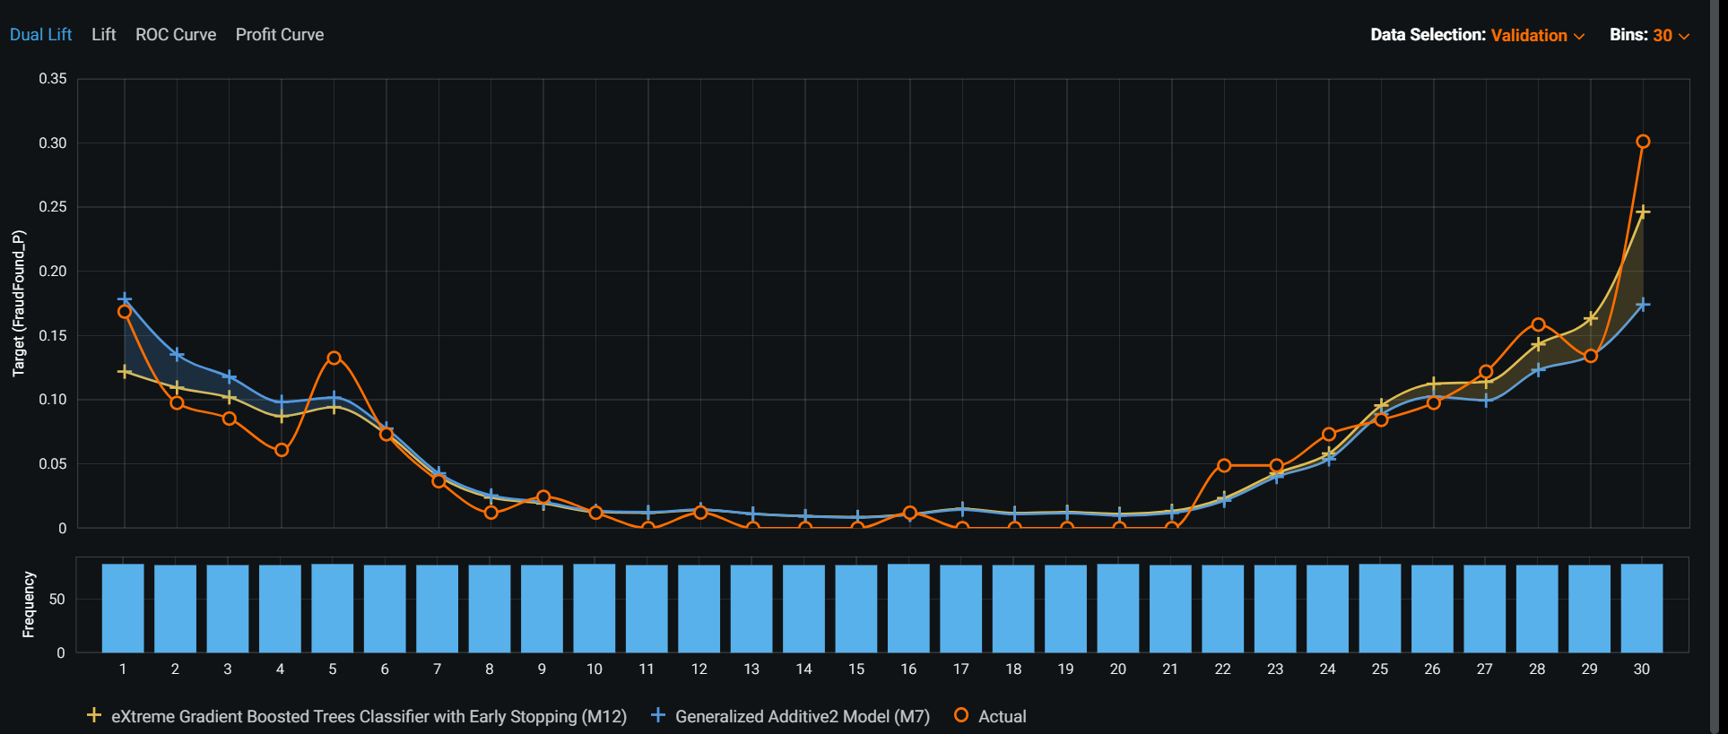
Model Identification by Dual – Lift Curve

Slide 16
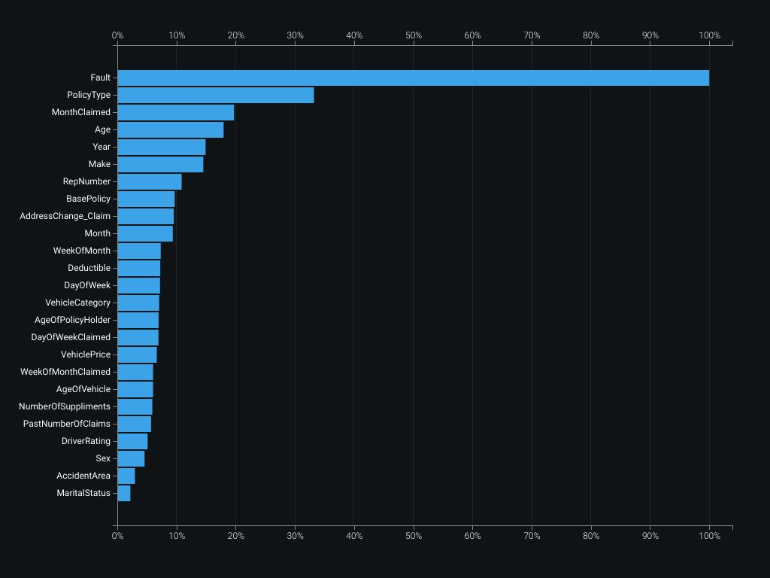
Feature Impact

Slide 17
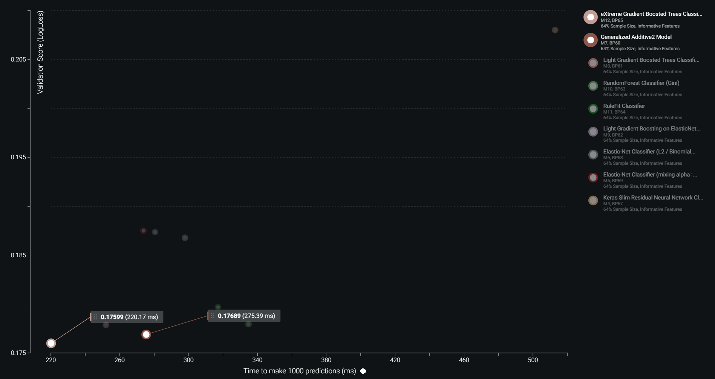
Speed versus accuracy

Slide 18
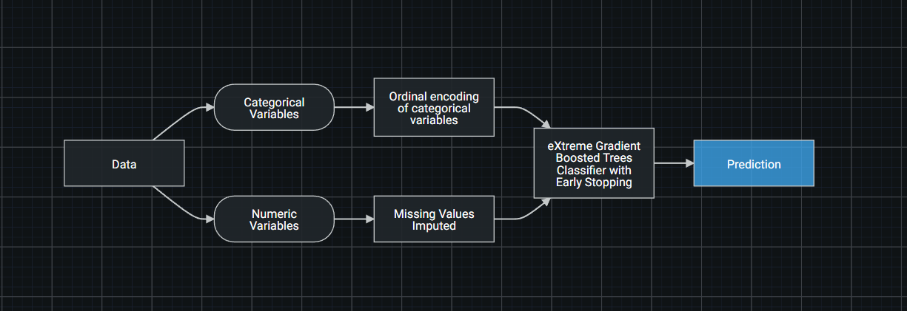
Blueprint of the Model

Slide 19
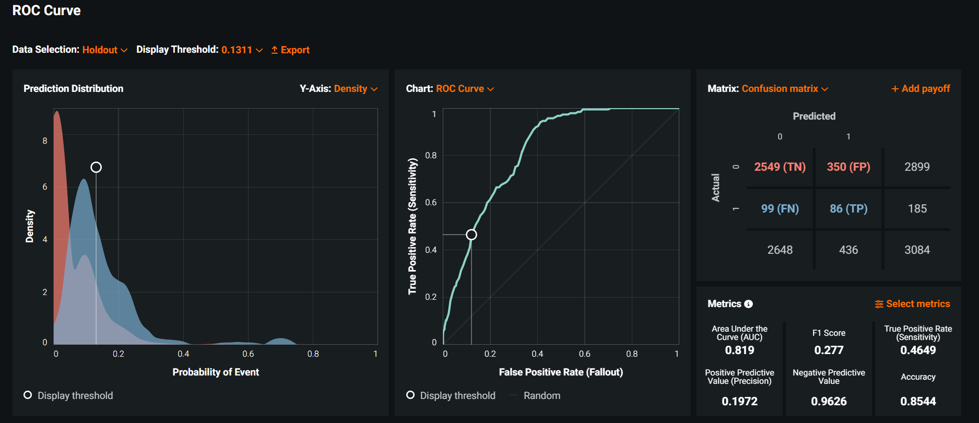
ROC CURVE & CUNFUSION MATRIX ON HOLDOUT DATA

Slide 20
Key Insights
From the 33 attributes in the dataset 5 attributes have the direct impact on predicting target.
If the policyholder is the one who caused the accident, the risk of fraud is high.
Middle-aged people are more likely to commit fraud.
The majority of insurance claim frauds are reported under collision base policy, and they are using Pontiac and toyato sedan.

Slide 21
Recommendation
Based on the information we provided, we strongly advise the business team to implement a system to flag future fraud claims.
we can predict the Fraud claims with minimum personal information from the customer with high accuracy.
By increasing the sample size, the accuracy of the model can be Improved.

Slide 22
THANKS!
Any questions?

